Slide 1
Data Mining: Data

Slide 2
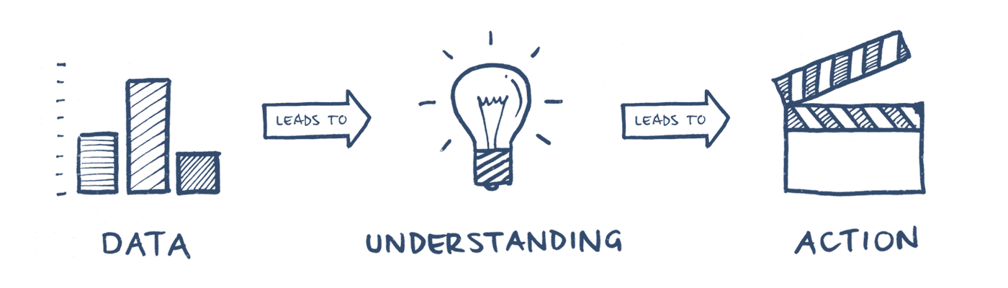
Important Steps Before Mining
Involves having a closer look at attributes
and data values
The first step is to collect the data
Understanding the data
Finding the main goals of the analysis
Business understanding is a key task
Data Pre-processing: Get the data ready

Slide 3
Outline
Attributes and Objects
Types of Data
Basic Statistical Description of Data
Data Quality
Similarity and Distance
Data Preprocessing

Slide 4
What is Data?
Collection of data objects and their attributes
An attribute is a property or characteristic of an object
Examples: eye color of a person, temperature, etc.
Attribute is also known as variable, field, characteristic, dimension, or feature
A collection of attributes describe an object
Object is also known as record, point, case, sample, entity, or instance
Attributes
Objects

Slide 5
Basic Type
Nondependency-Oriented Data: most multidimensional data
Dependency-Oriented data:
Implicit dependency
Time series
Explicit dependency
Graph

Slide 6
Attribute Values
Attribute values are numbers or symbols assigned to an attribute for a particular object
Distinction between attributes and attribute values
Same attribute can be mapped to different attribute values
Example: height can be measured in feet or meters
Different attributes can be mapped to the same set of values
Example: Attribute values for ID and age are integers
But properties of attribute can be different than the properties of the values used to represent the attribute

Slide 7
Measurement of Length
The way you measure an attribute may not match the attributes properties.
This scale preserves only the ordering property of length.
This scale preserves the ordering and additivity properties of length.

Slide 8
Types of Attributes
There are different types of attributes
Nominal
Examples: ID numbers, eye color, zip codes
Ordinal
Examples: rankings (e.g., taste of potato chips on a scale from 1-10), grades, height {tall, medium, short}
Interval
Examples: calendar dates, temperatures in Celsius or Fahrenheit.
Ratio
Examples: temperature in Kelvin, length, counts, elapsed time (e.g., time to run a race)

Slide 9
Properties of Attribute Values
The type of an attribute depends on which of the following properties/operations it possesses:
Distinctness: = ≠
Order: < >
Differences are + - meaningful (Addition)
Ratios are * / meaningful (Multiplication)
Nominal attribute: distinctness
Ordinal attribute: distinctness & order
Interval attribute: distinctness, order & meaningful differences
Ratio attribute: all 4 properties/operations

Slide 10
Difference Between Ratio and Interval
Is it physically meaningful to say that a temperature of 10 ° is twice that of 5° on
the Celsius scale?
the Fahrenheit scale?
the Kelvin scale?
Consider measuring the height above average
If Bill’s height is three inches above average and Bob’s height is six inches above average, then would we say that Bob is twice as tall as Bill?
Is this situation analogous to that of temperature?

Slide 11
This categorization of attributes is due to S. S. Stevens

Slide 12
This categorization of attributes is due to S. S. Stevens

Slide 13
Discrete and Continuous Attributes
Discrete Attribute
Has only a finite or countably infinite set of values
Examples: zip codes, counts, or the set of words in a collection of documents
Often represented as integer variables.
Note: binary attributes are a special case of discrete attributes
Continuous Attribute
Has real numbers as attribute values
Examples: temperature, height, or weight.
Practically, real values can only be measured and represented using a finite number of digits.
Continuous attributes are typically represented as floating-point variables.

Slide 14
Asymmetric Attributes
Only presence (a non-zero attribute value) is regarded as important
Words present in documents
Items present in customer transactions
If we met a friend in the grocery store would we ever say the following? “I see our purchases are very similar since we didn’t buy most of the same things.”

Slide 15
Critiques of the attribute categorization
Incomplete
Symmetric binary
Cyclical
Multivariate
Partially ordered
Partial membership
Relationships between the data
Real data is approximate and noisy
This can complicate recognition of the proper attribute type
Treating one attribute type as another may be approximately correct

Slide 16
Key Messages for Attribute Types
The types of operations you choose should be “meaningful” for the type of data you have
Distinctness, order, meaningful intervals, and meaningful ratios are only four (among many possible) properties of data
The data type you see – often numbers or strings – may not capture all the properties or may suggest properties that are not present
Analysis may depend on these other properties of the data
Many statistical analyses depend only on the distribution
In the end, what is meaningful can be specific to domain

Slide 17
Important Characteristics of Data
Dimensionality (number of attributes)
High dimensional data brings a number of challenges
Distribution: Sparsity
Only presence counts
Resolution
Patterns depend on the scale
Size
Type of analysis may depend on size of data

Slide 18
Types of data sets
Record
Data Matrix
Document Data
Transaction Data
Graph
World Wide Web
Molecular Structures
Ordered
Spatial Data
Temporal Data
Sequential Data
Genetic Sequence Data

Slide 19
Record Data
Data that consists of a collection of records, each of which consists of a fixed set of attributes

Slide 20
Data Matrix
If data objects have the same fixed set of numeric attributes, then the data objects can be thought of as points in a multi-dimensional space, where each dimension represents a distinct attribute
Such a data set can be represented by an m by n matrix, where there are m rows, one for each object, and n columns, one for each attribute

Slide 21
Document Data
Each document becomes a ‘term’ vector
Each term is a component (attribute) of the vector
The value of each component is the number of times the corresponding term occurs in the document.

Slide 22
Transaction Data
A special type of data, where
Each transaction involves a set of items.
For example, consider a grocery store. The set of products purchased by a customer during one shopping trip constitute a transaction, while the individual products that were purchased are the items.
Can represent transaction data as record data

Slide 23
Graph Data
Examples: Generic graph, a molecule, and webpages
Benzene Molecule: C6H6

Slide 24
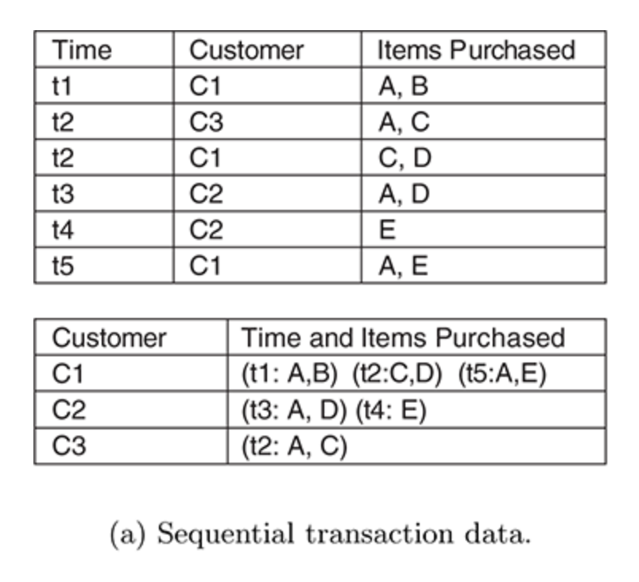
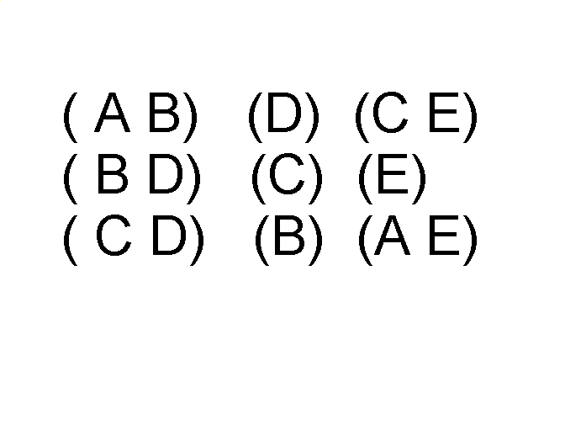
Ordered Data
Sequences of transactions
Items/Events
An element of the sequence

Slide 25
Ordered Data
Genomic sequence data

Slide 26
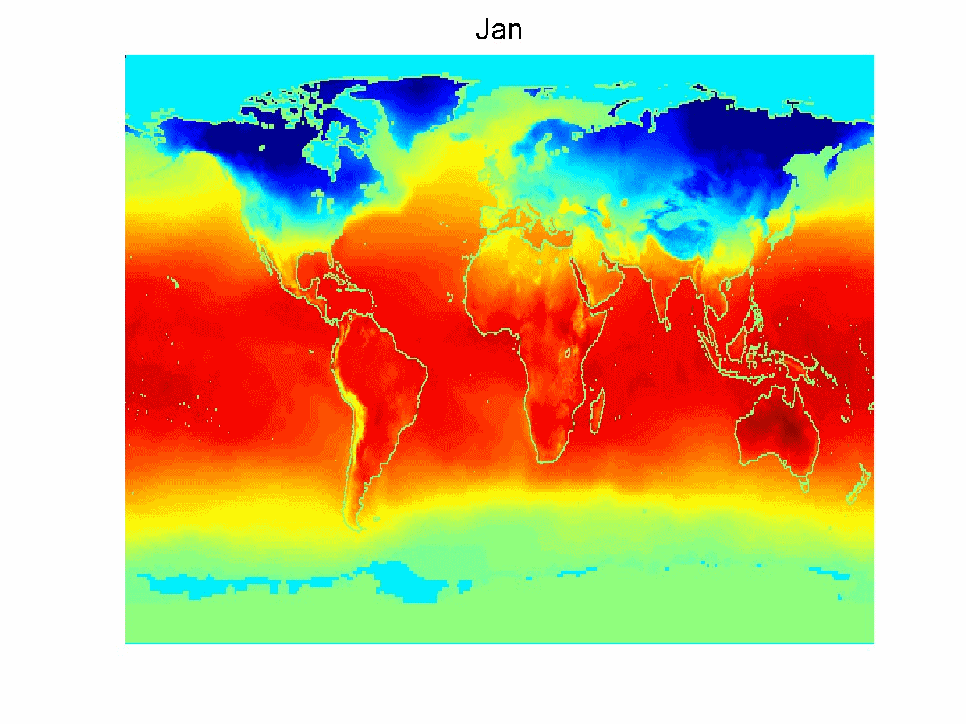
Ordered Data
Spatio-Temporal Data
Average Monthly Temperature of land and ocean

Slide 27
Basic Statistical Description
Measure of central tendency: measure the location of the middle or center of the data distribution.
Given an attribute, where do most of its value fall?
Dispersion of the data: How are the data spread out?
Visualization: using graphic displays of basic statistical descriptions visually inspect the data.
Notes:
Basic statistical description can be used to identify properties of data and highlight which data values should be treated as noise or outliers.

Slide 28
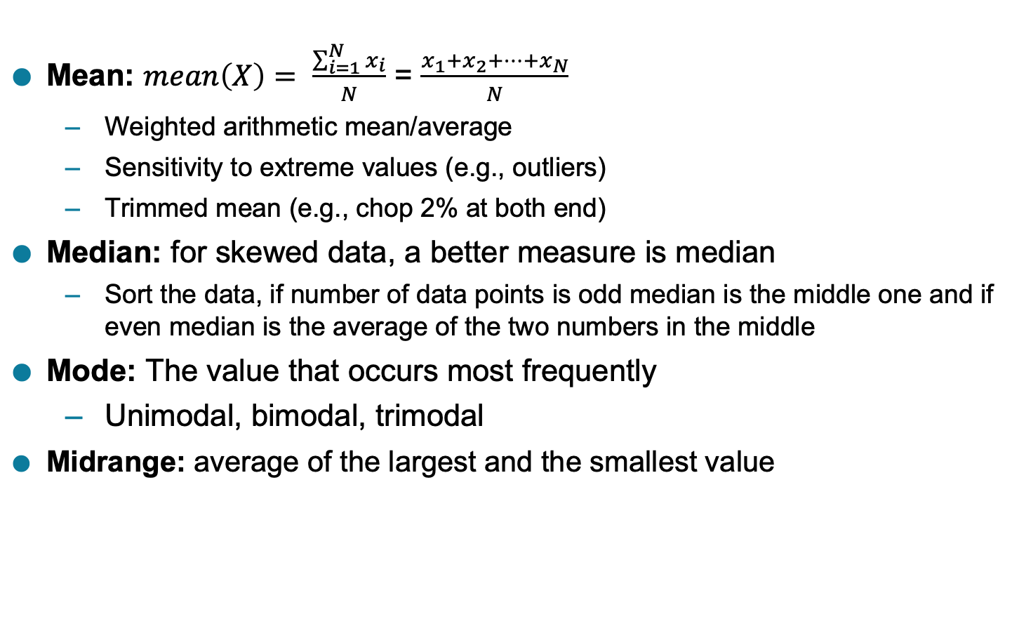
Measuring the Central Tendency: Where do most of the data values fall?
Mean: $mean\left(X\right)= \frac{\sum_{i=1}^{N}{x_{i}}}{N}$ = $\frac{x_{1}+x_{2}+…+x_{N}}{N}$
Weighted arithmetic mean/average
Sensitivity to extreme values (e.g., outliers)
Trimmed mean (e.g., chop 2% at both end)
Median: for skewed data, a better measure is median
Sort the data, if number of data points is odd median is the middle one and if even median is the average of the two numbers in the middle
Mode: The value that occurs most frequently
Unimodal, bimodal, trimodal
Midrange: average of the largest and the smallest value
Notes:
For unimodal numeric data that are moderately skewed (asymmetric), we have the following empirical relation:
(mean – mode) $≈$ 3 X (mean - median)
Midrange: average of the largest and the smallest value

Slide 29
Example: Central Tendency
Suppose we have the following values for salary (in thousands of dollars), shown in increasing order: 30, 36, 47, 50, 52, 52, 56, 60, 63, 70, 70, 110.
Find mean.
Find Median.
Find Mode.
Find Midrange.

Slide 30
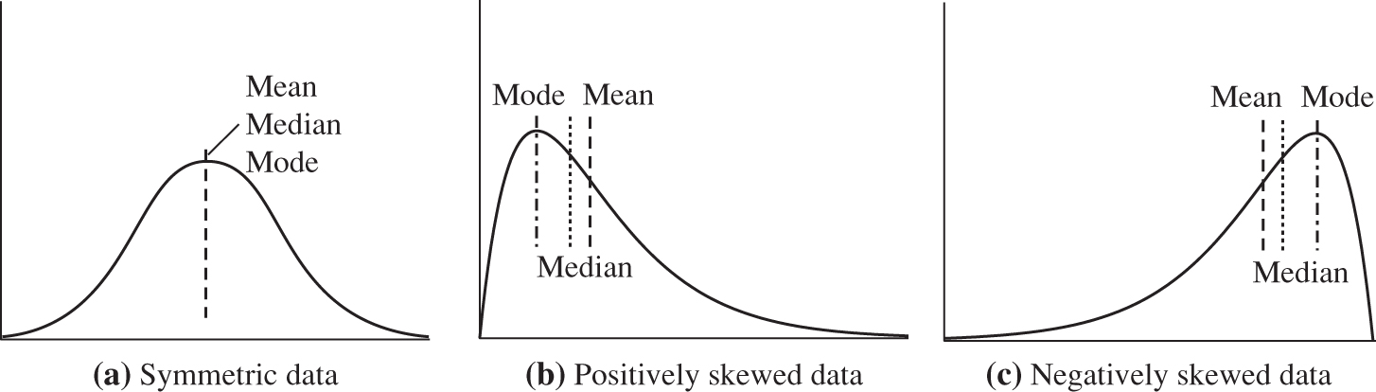
Example: Mean, Median, Mode
Figure Mean, median, and mode of symmetric versus positively and negatively skewed data.

Slide 31
Measuring the Dispersion of Data
Range
Quantiles
Quartiles
Percentiles
Interquartile range
Five-number summary – displayed as boxplot: useful for finding outliers
Variance
Standard Deviation

Slide 32
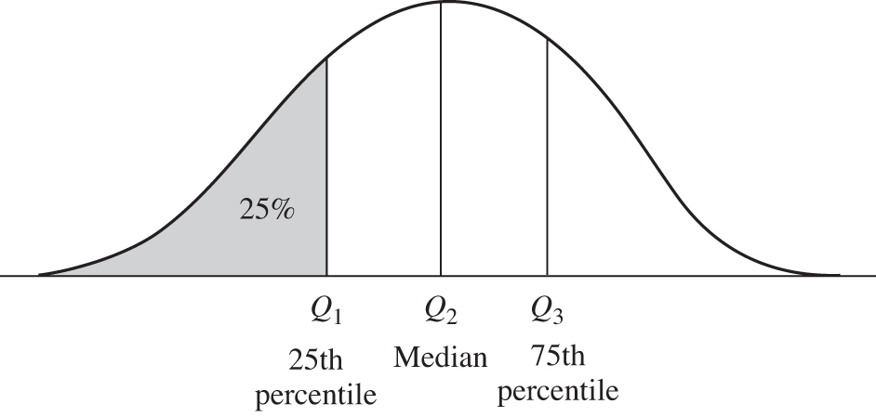
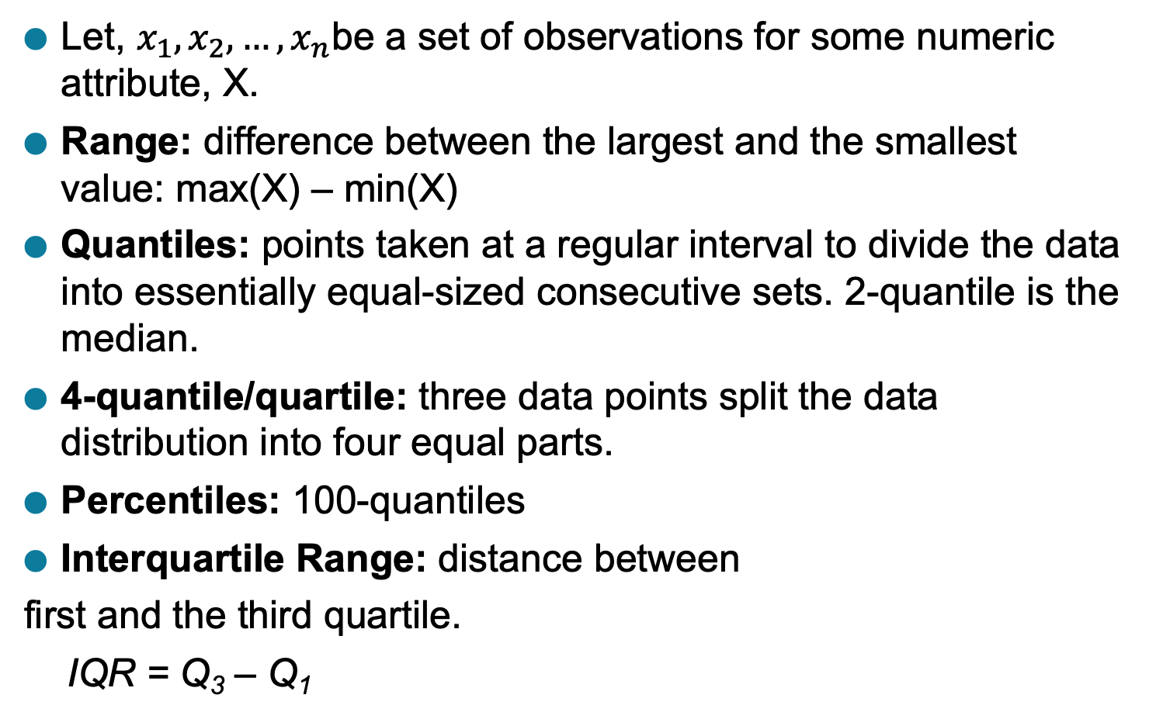
Range, Quartiles and Interquartile Range
Let, $x_{1}, x_{2}, …, x_{n}$be a set of observations for some numeric attribute, X.
Range: difference between the largest and the smallest value: max(X) – min(X)
Quantiles: points taken at a regular interval to divide the data into essentially equal-sized consecutive sets. 2-quantile is the median.
4-quantile/quartile: three data points split the data distribution into four equal parts.
Percentiles: 100-quantiles
Interquartile Range: distance between
first and the third quartile.
IQR = Q₃ – Q₁
Figure: Quartiles
Notes:
A common rule of thumb for identifying a suspected outlier is to single out values falling at least 1.5 X IQR above the third quartile or below the first quartile

Slide 33
Measuring the Dispersion of Data
Range
Quantiles
Quartiles
Percentiles
Interquartile range
Five-number summary – displayed as boxplot: useful for finding outliers
Variance
Standard Deviation

Slide 34
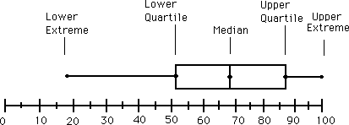
Five-Number Summary, Boxplots, and Outliers
Minimum, Q₁, Median (Q₂), Q₃, and Maximum
Identifying Outliers: values falling at least 1.5 X IQR above the third quartile or below the first quartile.
Boxplots are popular way of visualization. Shows five-number summary.
Ends of the box are quartiles, so the box length is IQR
Median is marked by a line in the box
Two lines outside the box extend
to the minimum and maximum
observations.
Notes:
No single numeric measure of spread is very useful for describing skewed distribution.

Slide 35
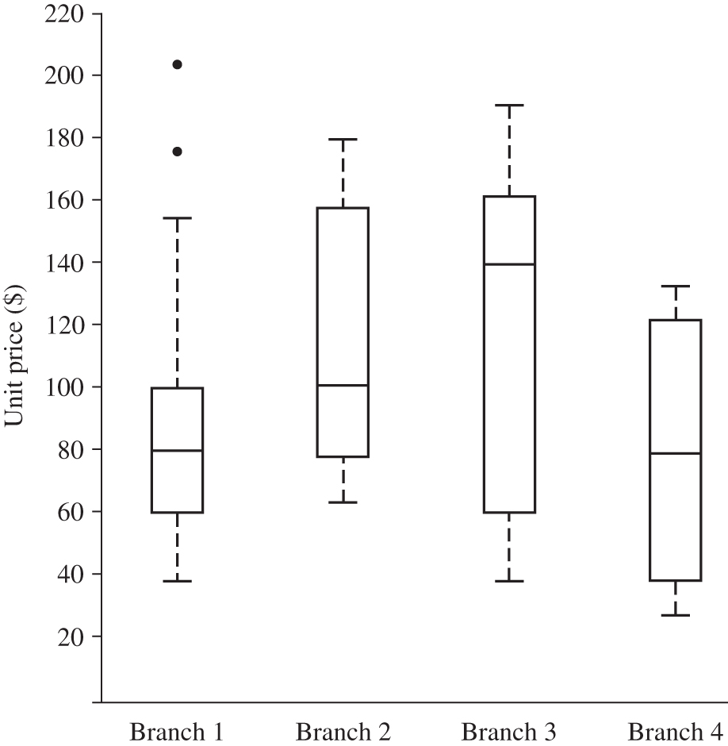
Example: Five-Number Summary, Boxplots, and Outliers
Outliers
Figure Boxplot for the unit price data for items sold at four branches of AllElectronics during a given time period.

Slide 36
Measuring the Dispersion of Data
Range
Quantiles
Quartiles
Percentiles
Interquartile range
Five-number summary – displayed as boxplot: useful for finding outliers
Variance
Standard Deviation

Slide 37
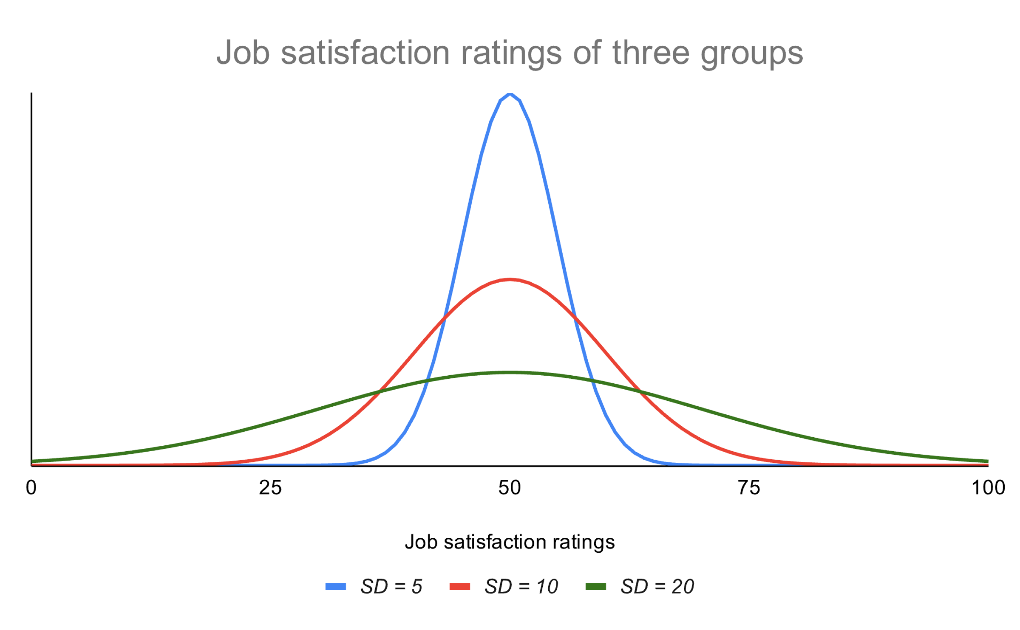
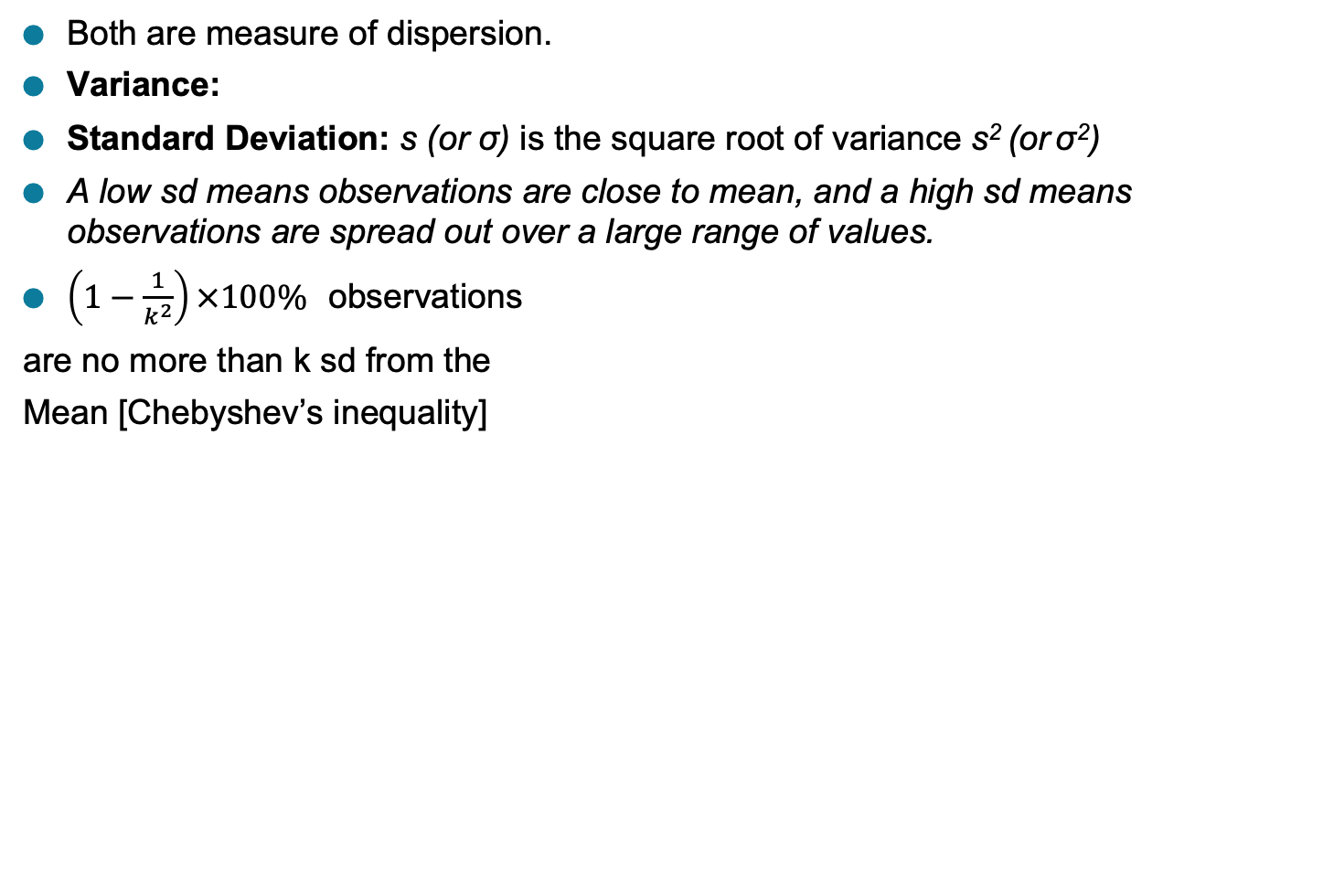
Variance and Standard Deviation
Both are measure of dispersion.
Variance:
Standard Deviation: s (or σ) is the square root of variance s² (or σ²)
A low sd means observations are close to mean, and a high sd means observations are spread out over a large range of values.
$\left(1−\frac{1}{k^{2}}\right)×100\%$ observations
are no more than k sd from the
Mean [Chebyshev’s inequality]

Slide 38
Graphic Displays of Basic Statistical Descriptions of Data
Boxplot: graphic display of five-number summary
Histogram: x-axis are values, y-axis represent frequencies
Quantile plot: each value x_{i} is paired with f_{i} indicating that approximately 100 f_{i} % of data are ≤ x_{i}
Quantile-quantile (q-q) plot: graphs the quantiles of one univariant distribution against the corresponding quantiles of another
Scatter plot: each pair of values is a pair of coordinates and plotted as points in the plane

Slide 39
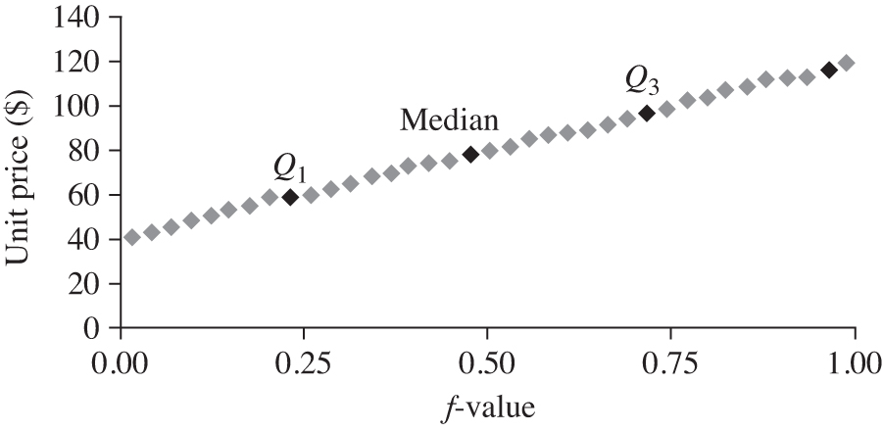
Quantile plot
Displays all of the data (allowing the user to assess both the overall behavior and unusual occurrences)
Plots quantile information
For a data x_{i} sorted in increasing order, f_{i} indicates that approximately 100 f_{i}% of the data are below or equal to the value x_{i}

Slide 40
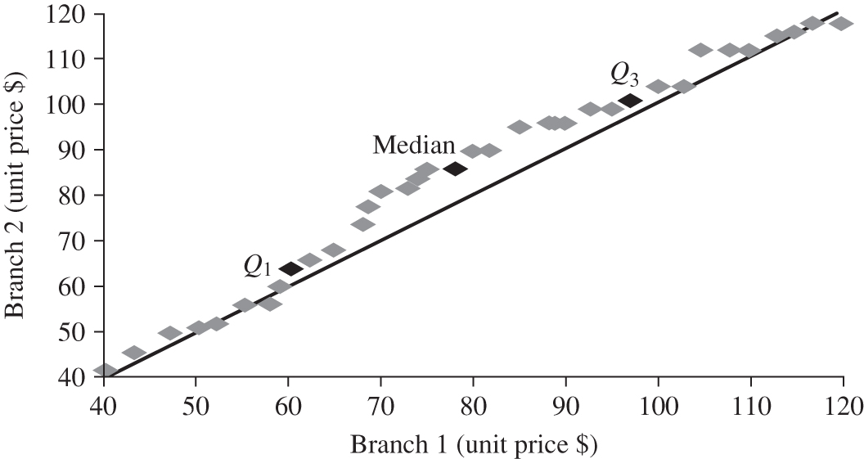
Quantile-Quantile Plot
Graphs the quantiles of one univariate distribution against the corresponding quantiles of another
View: Is there is a shift in going from one distribution to another?
Example shows unit price of items sold at Branch 1 vs. Branch 2 for each quantile. Unit prices of items sold at Branch 1 tend to be lower than those at Branch 2.

Slide 41
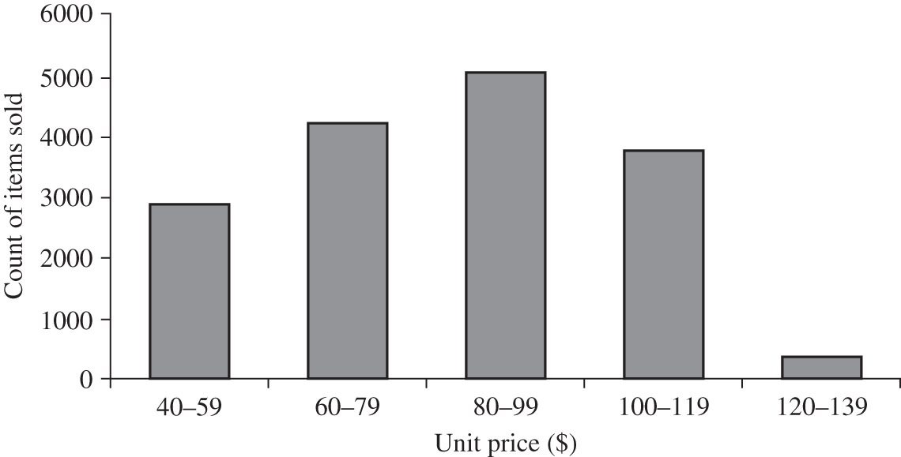
Histograms
Graph display of tabulated frequencies, shown as bars

Slide 42
Histograms Often tells more than Boxplots
The two histograms shown in the left may have the same boxplot representation
The same values for: min, Q1, median, Q3, max
But they have rather different data distributions
42

Slide 43
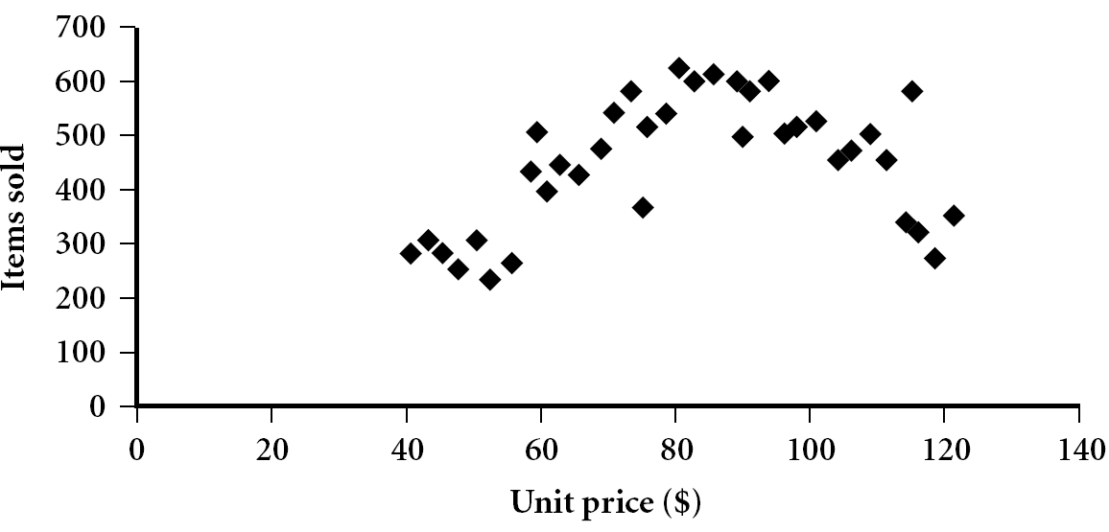
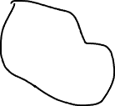
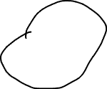
Scatter Plots
Provides a first look at bivariate data to see clusters of points, outliers, etc
Each pair of values is treated as a pair of coordinates and plotted as points in the plane

Slide 44
Positively and Negatively Correlated Data
The left half fragment is positively correlated
The right half is negative correlated

Slide 45
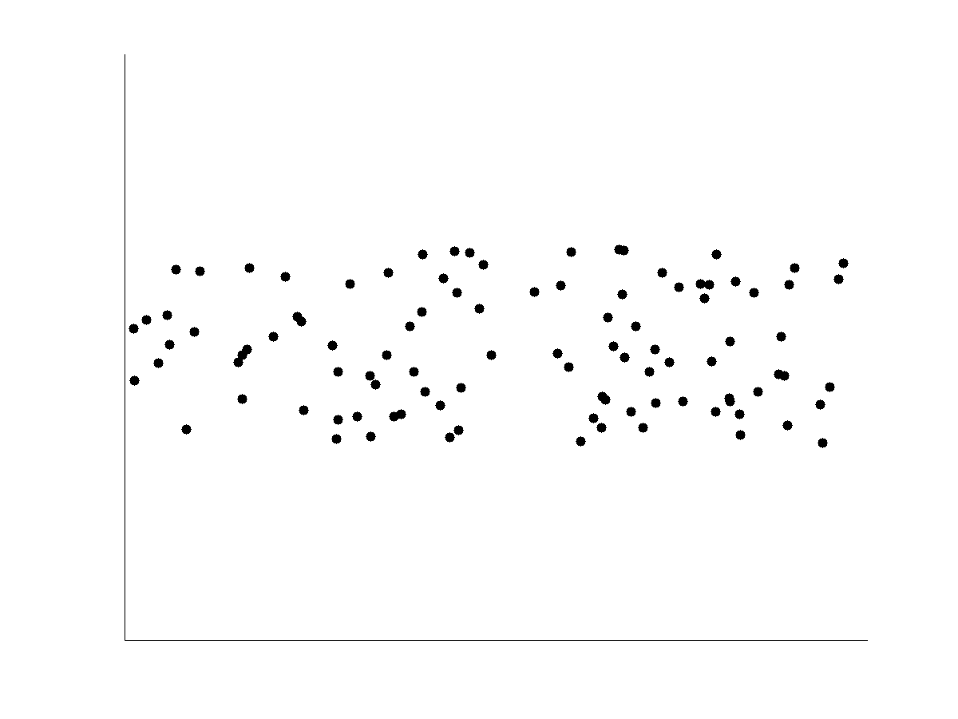
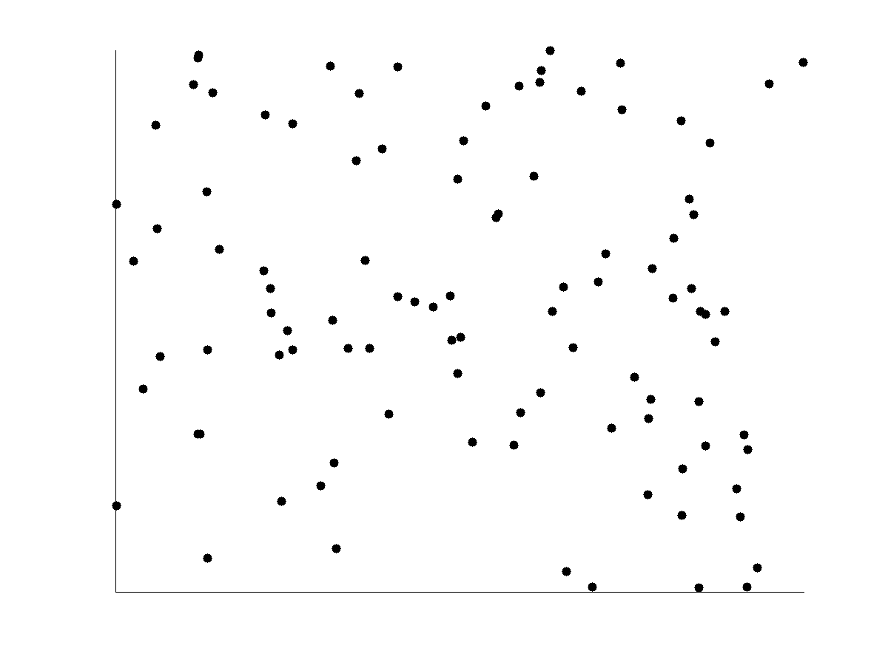
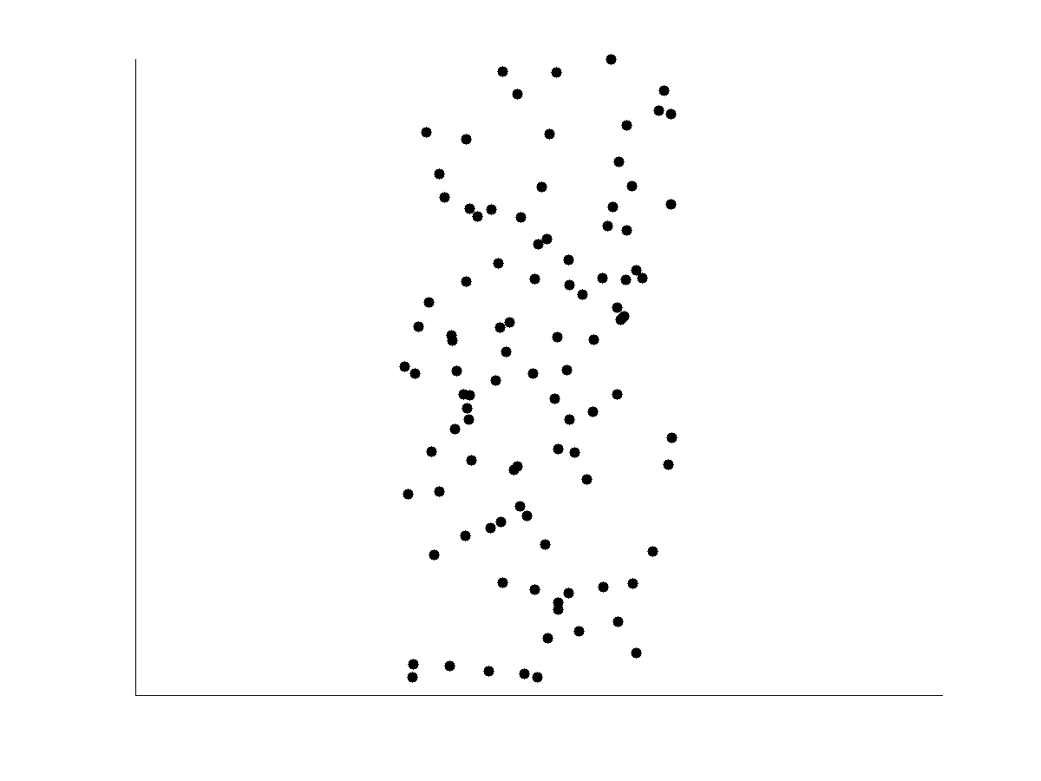
Uncorrelated Data

Slide 46
Data Quality
Poor data quality negatively affects many data processing efforts
Data mining example: a classification model for detecting people who are at loan risks is built using poor data
Some credit-worthy candidates are denied loans
More loans are given to individuals that default

Slide 47
Data Quality …
What kinds of data quality problems?
How can we detect problems with the data?
What can we do about these problems?
Examples of data quality problems:
Measurement and Data Collection Errors
Noise and outliers
Wrong data
Fake data
Missing values
Duplicate data

Slide 48
Noise
For objects, noise is an extraneous object
For attributes, noise refers to modification of original values
Examples: distortion of a person’s voice when talking on a poor phone and “snow” on television screen
The figures below show two sine waves of the same magnitude and different frequencies, the waves combined, and the two sine waves with random noise
The magnitude and shape of the original signal is distorted
Notes:
Precision, Bias, Accuracy
Bias – selection bias, response bias
Undercoverage occurs when certain members of a population are inadequately represented in a sample.
Nonresponse bias occurs when a sample is biased toward members of a population that participate in a survey.
Voluntary response bias occurs when a sample is biased toward members that self-select for participation in a survey.
Acquiescence bias occurs when respondents tend to agree with a statement in a survey.
Extreme responding occurs when respondents tend to select the most extreme options available.
Social desirability bias occurs when respondents tend to answer questions in a way that is socially accepted by others. In other words, a social desirability bias exists when respondents over-report "good" behaviors or under-report "bad" behaviors.

Slide 49

Outliers
Outliers are data objects with characteristics that are considerably different than most of the other data objects in the data set
Case 1: Outliers are noise that interferes with data analysis
Case 2: Outliers are the goal of our analysis
Credit card fraud
Intrusion detection
Causes?

Slide 50
Missing Values
Reasons for missing values
Information is not collected (e.g., people decline to give their age and weight)
Attributes may not be applicable to all cases (e.g., annual income is not applicable to children)
Handling missing values
Eliminate data objects or variables
Estimate missing values
Example: time series of temperature
Example: census results
Ignore the missing value during analysis
Notes:
Inconsistent vslues

Slide 51
Duplicate Data
Data set may include data objects that are duplicates, or almost duplicates of one another
Major issue when merging data from heterogeneous sources
Examples:
Same person with multiple email addresses
Data cleaning
Process of dealing with duplicate data issues
When should duplicate data not be removed?

Slide 52
Data Preprocessing
Aggregation
Sampling
Discretization and Binarization
Attribute/Variable Transformation
Dimensionality Reduction
Feature subset selection
Feature creation
Notes:
Fall into two broad categories – Selection and Creation

Slide 53
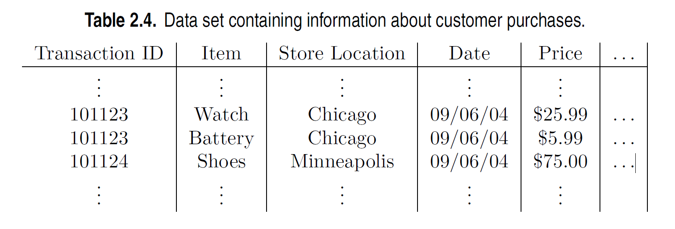
Aggregation
Combining two or more attributes (or objects) into a single attribute (or object)
Purpose
Data reduction - reduce the number of attributes or objects
Change of scale
Cities aggregated into regions, states, countries, etc.
Days aggregated into weeks, months, or years
More “stable” data - aggregated data tends to have less variability

Slide 54
Example: Precipitation in Australia
This example is based on precipitation in Australia from the period 1982 to 1993.
The next slide shows
A histogram for the standard deviation of average monthly precipitation for 3,030 0.5◦ by 0.5◦ grid cells in Australia, and
A histogram for the standard deviation of the average yearly precipitation for the same locations.
The average yearly precipitation has less variability than the average monthly precipitation.
All precipitation measurements (and their standard deviations) are in centimeters.

Slide 55
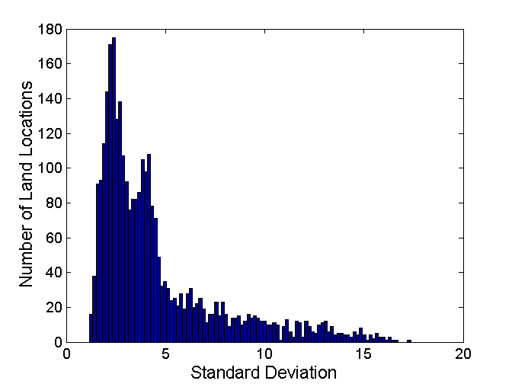
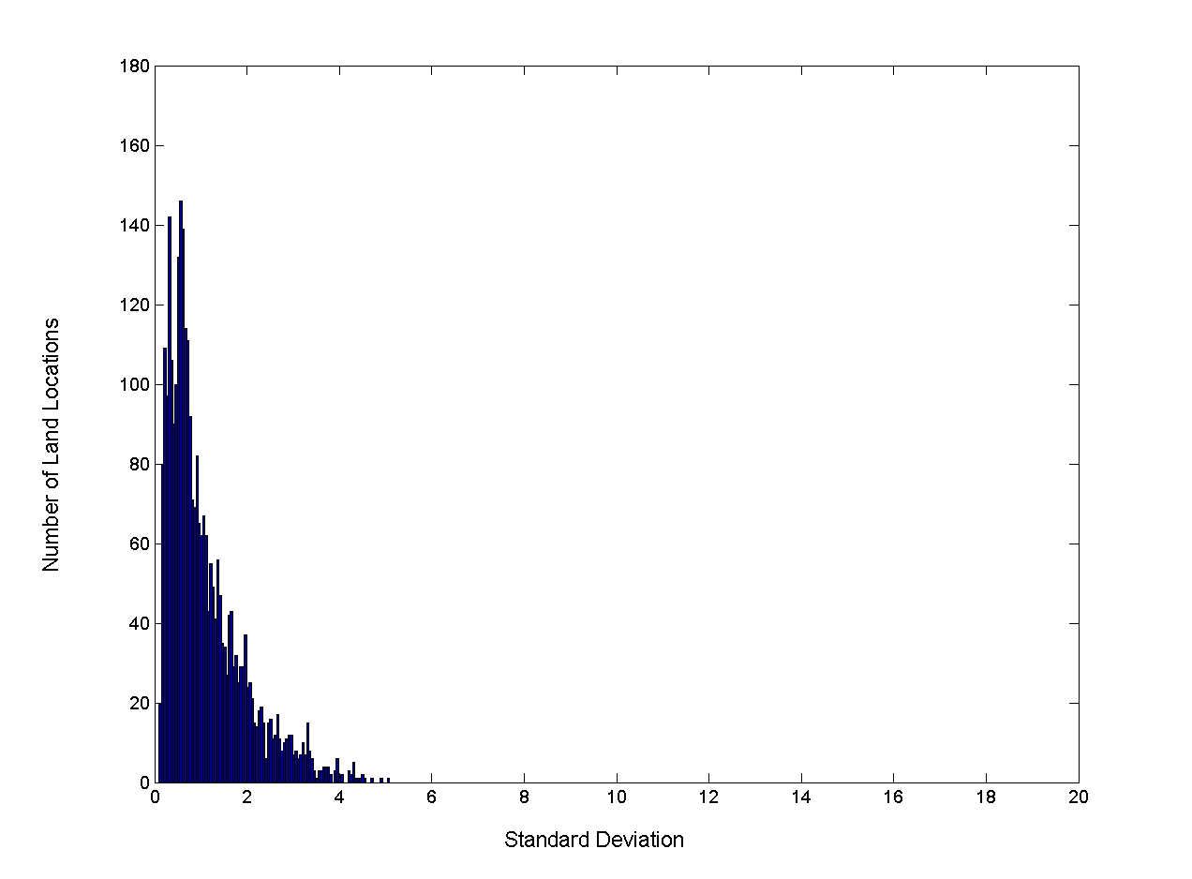
Example: Precipitation in Australia …
Variation of Precipitation in Australia
Standard Deviation of Average Monthly Precipitation
Standard Deviation of Average Yearly Precipitation
Notes:
Disadvantage of aggregation is a potential loss of interesting details.

Slide 56
Sampling
Sampling is the main technique employed for data reduction.
It is often used for both the preliminary investigation of the data and the final data analysis.
Statisticians often sample because obtaining the entire set of data of interest is too expensive or time consuming.
Sampling is typically used in data mining because processing the entire set of data of interest is too expensive or time consuming.

Slide 57
Sampling …
The key principle for effective sampling is the following:
Using a sample will work almost as well as using the entire data set, if the sample is representative
A sample is representative if it has approximately the same properties (of interest) as the original set of data

Slide 58

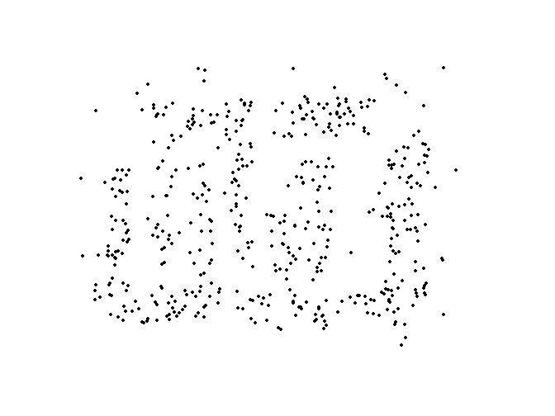
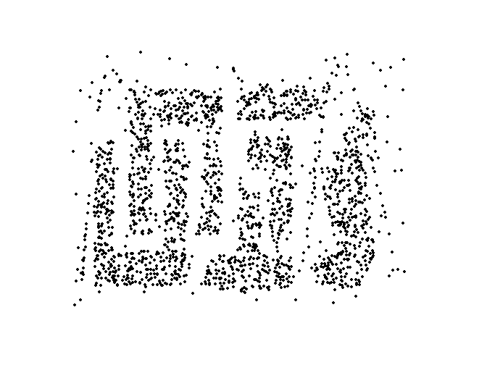
Sample Size
8000 points 2000 Points 500 Points

Slide 59
Types of Sampling
Simple Random Sampling
There is an equal probability of selecting any particular item
Sampling without replacement
As each item is selected, it is removed from the population
Sampling with replacement
Objects are not removed from the population as they are selected for the sample.
In sampling with replacement, the same object can be picked up more than once
Stratified sampling
Split the data into several partitions; then draw random samples from each partition

Slide 60
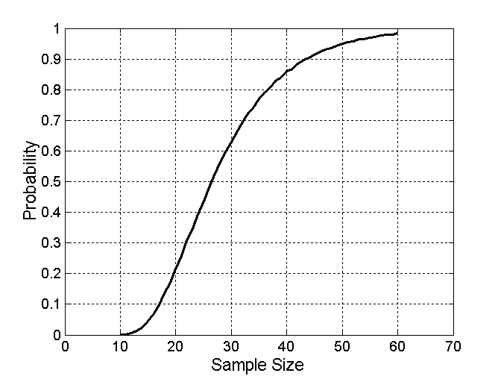
Sample Size
What sample size is necessary to get at least one object from each of 10 equal-sized groups.
Notes:
Progressive sampling

Slide 61
Discretization
Discretization is the process of converting a continuous attribute into an ordinal attribute
A potentially infinite number of values are mapped into a small number of categories
Discretization is used in both unsupervised and supervised settings

Slide 62
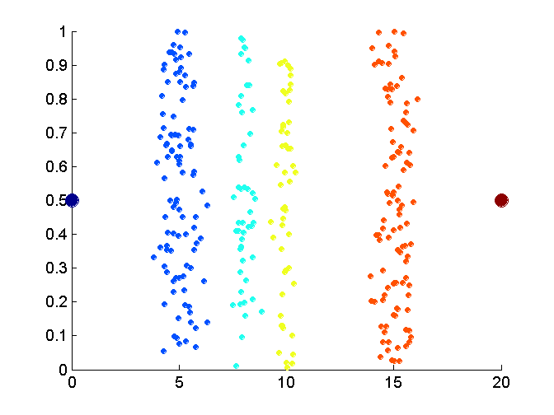
Unsupervised Discretization
Data consists of four groups of points and two outliers. Data is one-dimensional, but a random y component is added to reduce overlap.

Slide 63
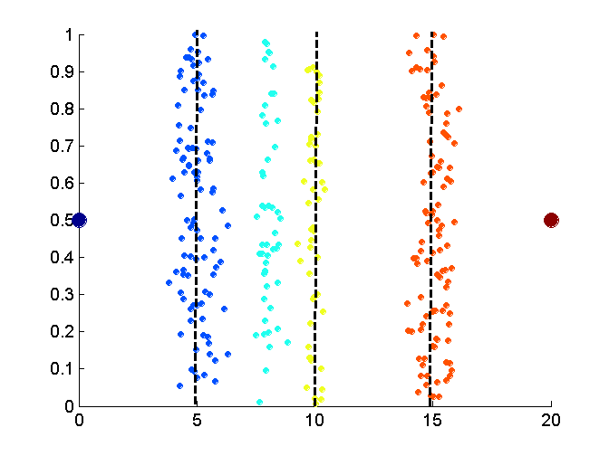
Unsupervised Discretization
Equal interval width approach used to obtain 4 values.

Slide 64
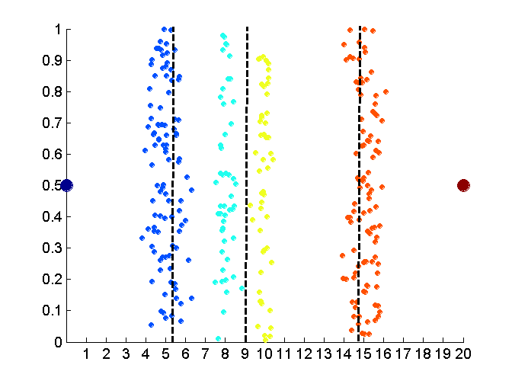
Unsupervised Discretization
Equal frequency approach used to obtain 4 values.

Slide 65
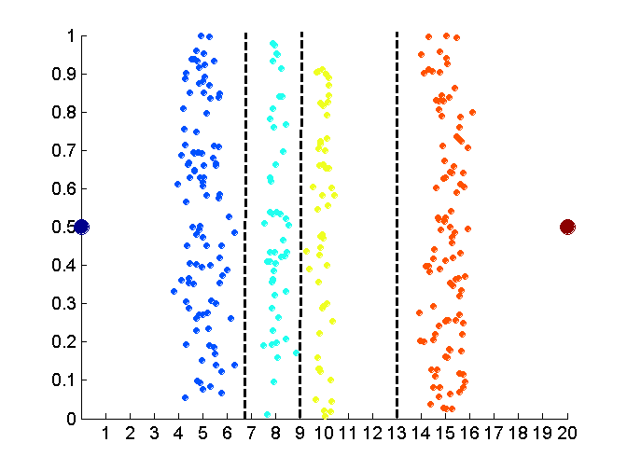
Unsupervised Discretization
K-means approach to obtain 4 values.

Slide 66
Discretization in Supervised Settings
Many classification algorithms work best if both the independent and dependent variables have only a few values
We give an illustration of the usefulness of discretization using the following example.

Slide 67
Binarization
Binarization maps a continuous or categorical attribute into one or more binary variables

Slide 68
Attribute Transformation
An attribute transform is a function that maps the entire set of values of a given attribute to a new set of replacement values such that each old value can be identified with one of the new values
Simple functions: x^{k}, log(x), e^{x}, |x|
Normalization
Refers to various techniques to adjust to differences among attributes in terms of frequency of occurrence, mean, variance, range
Take out unwanted, common signal, e.g., seasonality
In statistics, standardization refers to subtracting off the means and dividing by the standard deviation
Notes:
In statistics sqrt, log and 1/x is often used to transform data that does not have a Gaussian distribution into data that does.
Suppose the variable is the number of data bytes in a session. Then it will be advantageous to compress it using log10 transformation.
What is the desired property of the transformed attribute?
Does the order need to be maintained?
Does the transformation apply to all values, specially negative values and 0?
What is the effect of the transformation on the values between 0 and 1?

Slide 69
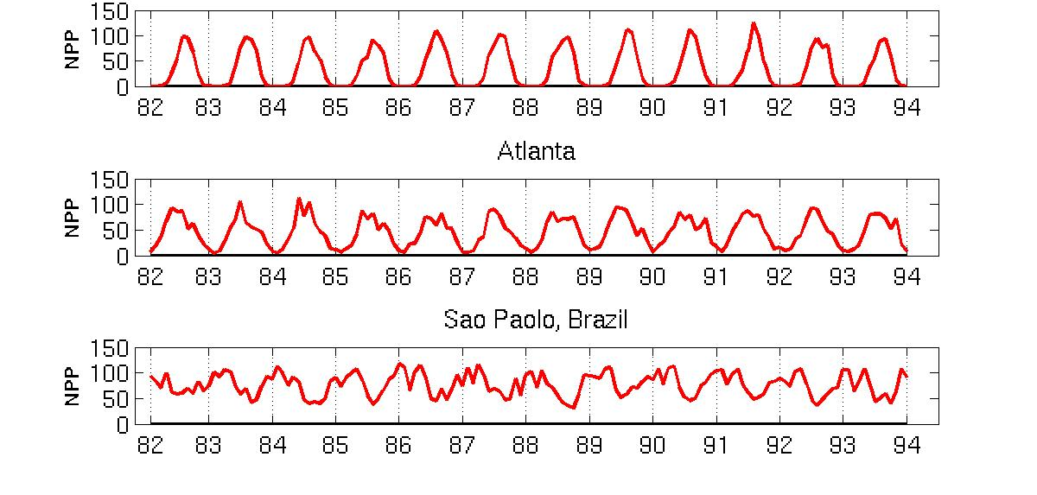
Example: Sample Time Series of Plant Growth
Minneapolis
Net Primary Production (NPP) is a measure of plant growth used by ecosystem scientists.
Correlations between time series
Correlations between time series

Slide 70
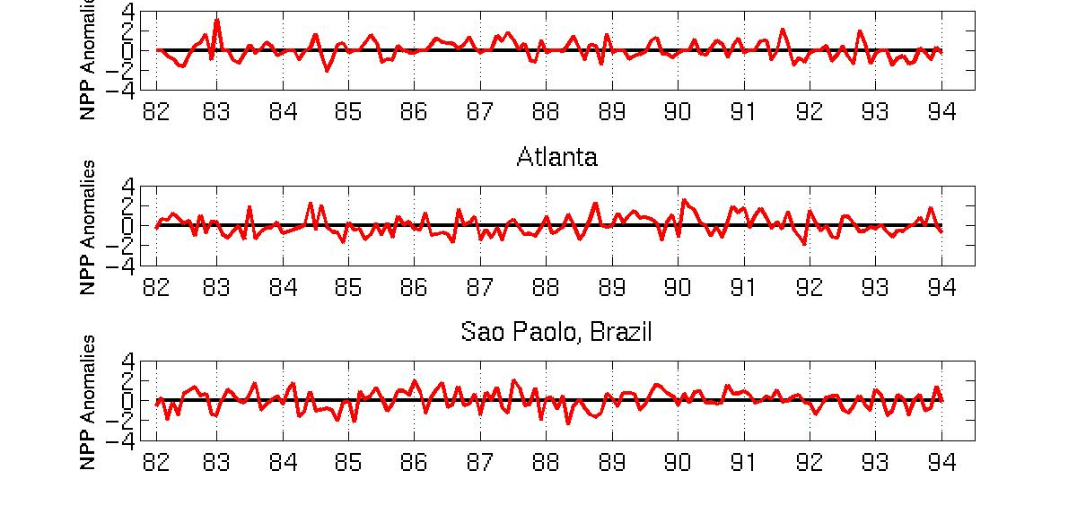
Seasonality Accounts for Much Correlation
Minneapolis
Normalized using monthly Z Score:
Subtract off monthly mean and divide by monthly standard deviation
Correlations between time series
Correlations between time series

Slide 71
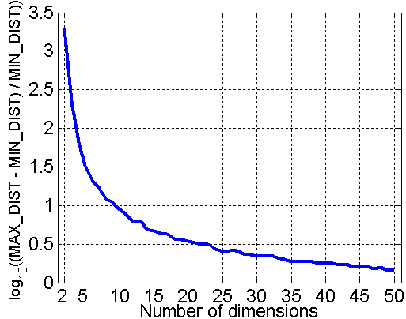
Curse of Dimensionality
When dimensionality increases, data becomes increasingly sparse in the space that it occupies
Definitions of density and distance between points, which are critical for clustering and outlier detection, become less meaningful
Randomly generate 500 points
Compute difference between max and min distance between any pair of points

Slide 72
Dimensionality Reduction
Purpose:
Avoid curse of dimensionality
Reduce amount of time and memory required by data mining algorithms
Allow data to be more easily visualized
May help to eliminate irrelevant features or reduce noise
Techniques
Principal Components Analysis (PCA)
Singular Value Decomposition
Others: supervised and non-linear techniques

Slide 73
Dimensionality Reduction: PCA
Goal is to find a projection that captures the largest amount of variation in data
x₂
e
x₁

Slide 74
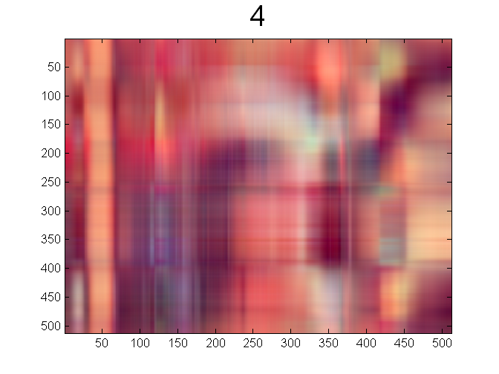
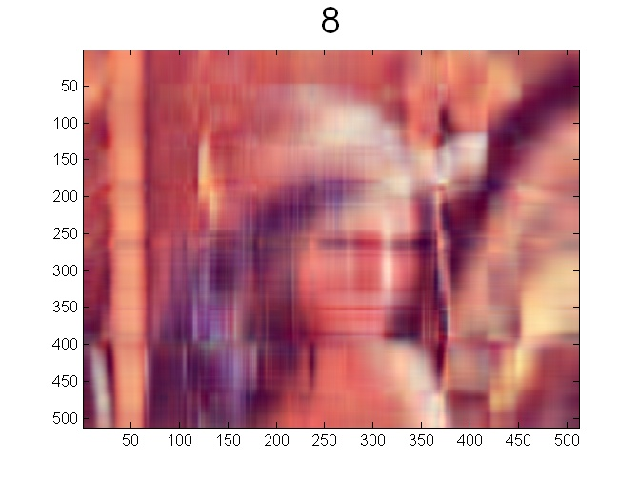


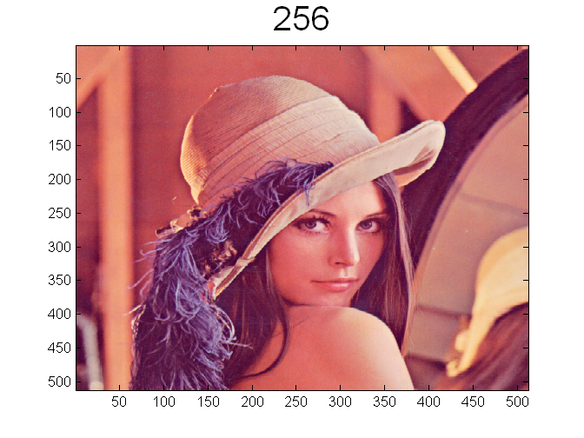
Dimensionality Reduction: PCA

Slide 75
Feature Subset Selection
Another way to reduce dimensionality of data
Redundant features
Duplicate much or all of the information contained in one or more other attributes
Example: purchase price of a product and the amount of sales tax paid
Irrelevant features
Contain no information that is useful for the data mining task at hand
Example: students' ID is often irrelevant to the task of predicting students' GPA
Many techniques developed, especially for classification
Notes:
Embedded, filter and wrapper

Slide 76
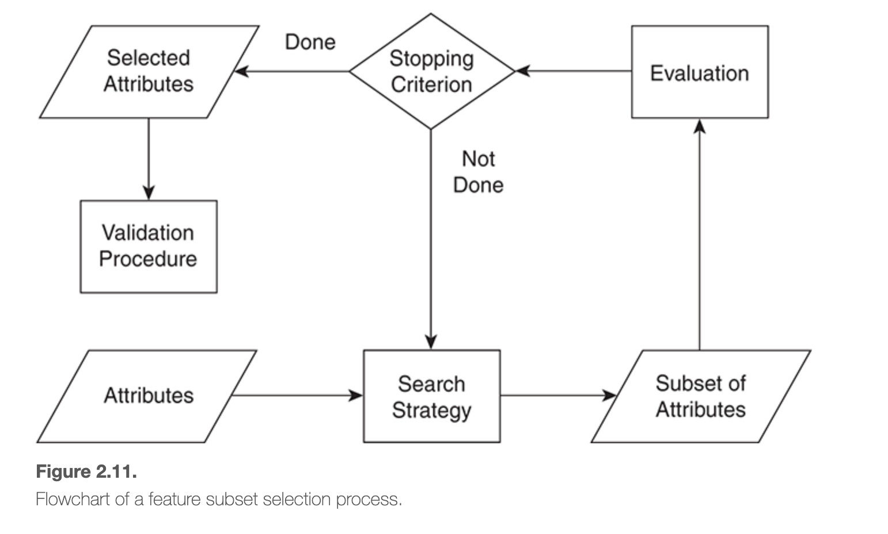
Feature Subset Selection
Notes:
Embedded approaches, Filter approach, Wrapper approach
Evaluating the subset, search for subsets, stopping criteria, validation
Feature weighing : SVM does that automatically

Slide 77
Feature Creation
Create new attributes that can capture the important information in a data set much more efficiently than the original attributes
Three general methodologies:
Feature extraction
Example: extracting edges from images
Feature construction
Example: dividing mass by volume to get density
Mapping data to new space
Example: Fourier and wavelet analysis

Slide 78
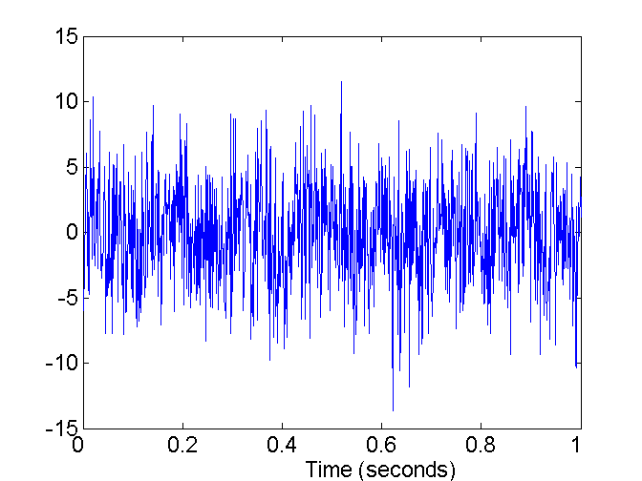
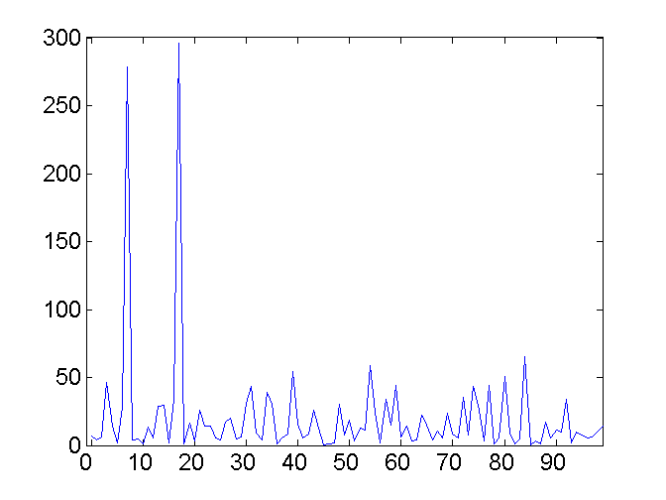
Mapping Data to a New Space
Fourier and wavelet transform
Frequency
Two Sine Waves + Noise
Frequency
Notes:
Fourier transform will provide the underlying frequencies of the data.

Slide 79
Proximity
Notes:
Similarity and dissimilarity are important because they are used by number of data mining techniques, such as clustering, nearest neighbor classification, and anomaly detection

Slide 80
Similarity and Dissimilarity Measures
Similarity measure
Numerical measure of how alike two data objects are.
Is higher when objects are more alike.
Often falls in the range [0,1]
Dissimilarity measure
Numerical measure of how different two data objects are
Lower when objects are more alike
Minimum dissimilarity is often 0
Upper limit varies
Proximity refers to a similarity or dissimilarity
Notes:
Transformation

Slide 81
Transformation
If given similarity is in [1,10] interval, use linear transformation to transform it in [0, 1]
s’ = (s – min_s)/(max_s – mis_s)
If dissimilarity is in the range [0, inf], linear transformation cannot be applied
d’ = d/(1+d)
Transformation can change the meaning, e.g., correlation
Transformation from s to d and d to s is possible
s = 1 – d
d = 1 - s
s = -d
s = 1/(1+d)
s = e^-d
s = 1 – (d-min_d)/(max_d-min_d)

Slide 82
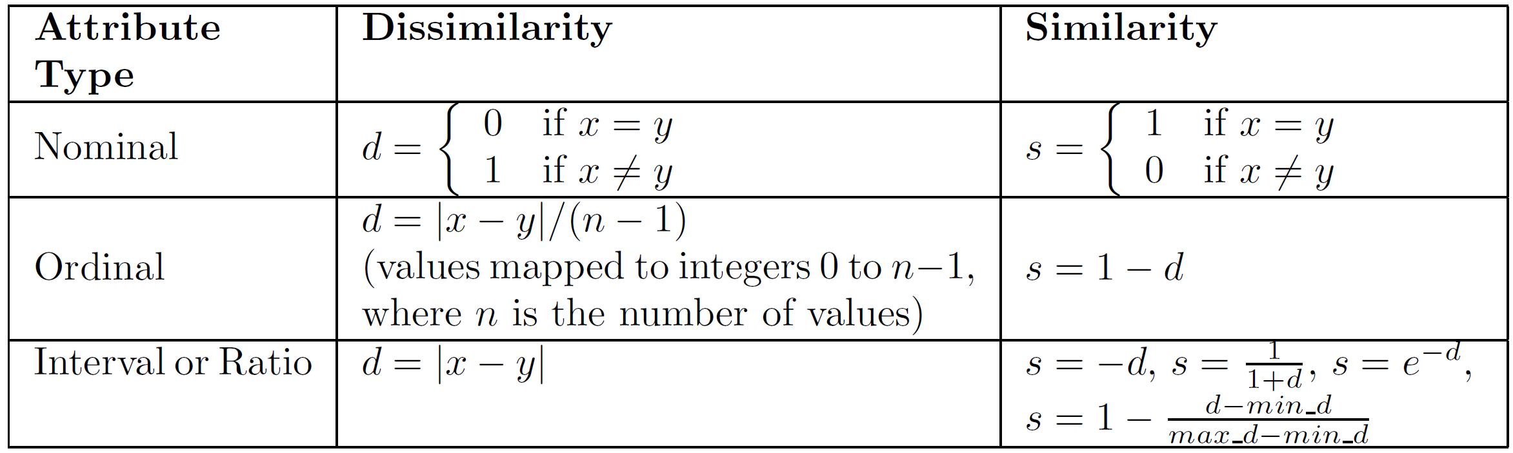
Similarity/Dissimilarity for Simple Attributes
The following table shows the similarity and dissimilarity between two objects, x and y, with respect to a single, simple attribute.

Slide 83
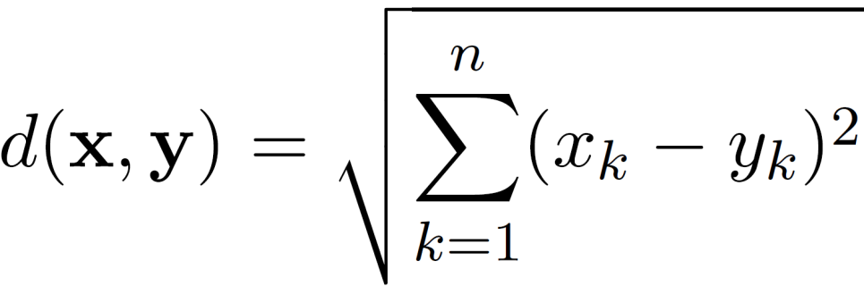
Euclidean Distance
Euclidean Distance
where n is the number of dimensions (attributes) and x_{k} and y_{k} are, respectively, the k^{th} attributes (components) or data objects x and y.
Standardization is necessary, if scales differ.

Slide 84
Euclidean Distance
Distance Matrix

Slide 85
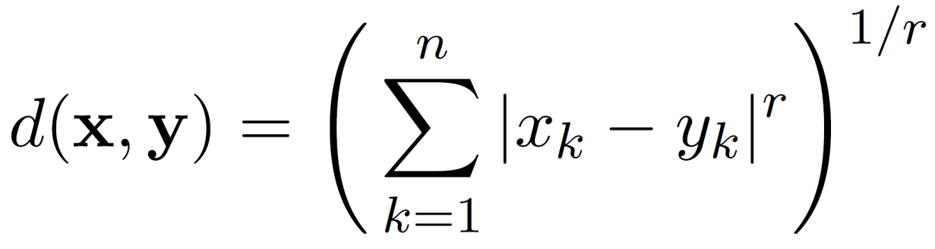
Minkowski Distance
Minkowski Distance is a generalization of Euclidean Distance
Where r is a parameter, n is the number of dimensions (attributes) and x_{k} and y_{k} are, respectively, the k^{th} attributes (components) or data objects x and y.

Slide 86
Minkowski Distance: Examples
r = 1. City block (Manhattan, taxicab, L₁ norm) distance.
A common example of this for binary vectors is the Hamming distance, which is just the number of bits that are different between two binary vectors
r = 2. Euclidean distance (L₂ norm)
r → ∞. “supremum” (L_{max} norm, L∞ norm) distance.
This is the maximum difference between any component of the vectors
Do not confuse r with n, i.e., all these distances are defined for all numbers of dimensions.

Slide 87
Minkowski Distance
Distance Matrix

Slide 88
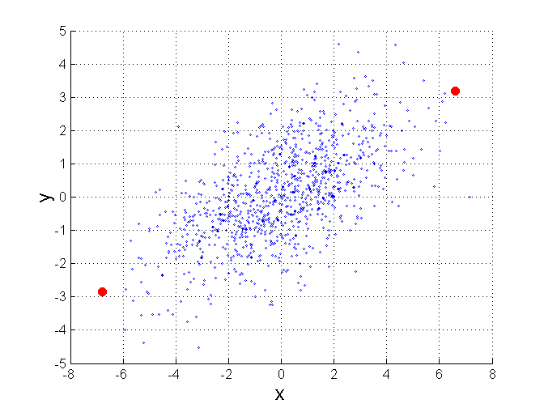
Mahalanobis Distance
$mahalanobis\left(x,y\right)={ ((x−y)}^{T}Ʃ^{−1}(x−y))$^{0.5}
Σ is the covariance matrix
Distance between a point and a
distribution
For red points, the Euclidean distance is 14.7, Mahalanobis distance is 6.

Slide 89
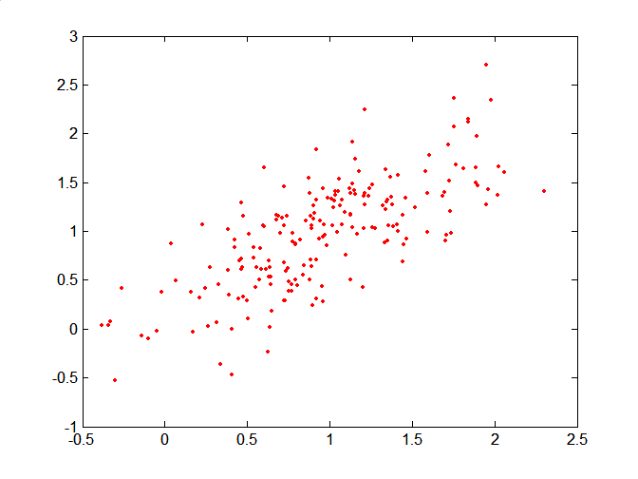
Mahalanobis Distance
Covariance Matrix:
C
B
A: (0.5, 0.5)
B: (0, 1)
C: (1.5, 1.5)
Mahal(A,B) = 5
Mahal(A,C) = 4
A

Slide 90
Common Properties of a Distance
Distances, such as the Euclidean distance, have some well known properties.
d(x, y) ≥ 0 for all x and y and d(x, y) = 0 if and only if x = y.
d(x, y) = d(y, x) for all x and y. (Symmetry)
d(x, z) ≤ d(x, y) + d(y, z) for all points x, y, and z. (Triangle Inequality)
where d(x, y) is the distance (dissimilarity) between points (data objects), x and y.
A distance that satisfies these properties is a metric

Slide 91
Common Properties of a Similarity
Similarities, also have some well known properties.
s(x, y) = 1 (or maximum similarity) only if x = y. (does not always hold, e.g., cosine)
s(x, y) = s(y, x) for all x and y. (Symmetry)
where s(x, y) is the similarity between points (data objects), x and y.

Slide 92
Similarity Between Binary Vectors
Common situation is that objects, x and y, have only binary attributes
Compute similarities using the following quantities
f₀₁ = the number of attributes where x was 0 and y was 1
f₁₀ = the number of attributes where x was 1 and y was 0
f₀₀ = the number of attributes where x was 0 and y was 0
f₁₁ = the number of attributes where x was 1 and y was 1
Simple Matching and Jaccard Coefficients
SMC = number of matches / number of attributes
= (f₁₁ + f₀₀) / (f₀₁ + f₁₀ + f₁₁ + f₀₀)
J = number of 11 matches / number of non-zero attributes
= (f₁₁) / (f₀₁ + f₁₀ + f₁₁)

Slide 93
SMC versus Jaccard: Example
x = 1 0 0 0 0 0 0 0 0 0
y = 0 0 0 0 0 0 1 0 0 1
f₀₁ = 2 (the number of attributes where x was 0 and y was 1)
f₁₀ = 1 (the number of attributes where x was 1 and y was 0)
f₀₀ = 7 (the number of attributes where x was 0 and y was 0)
f₁₁ = 0 (the number of attributes where x was 1 and y was 1)
SMC = (f₁₁ + f₀₀) / (f₀₁ + f₁₀ + f₁₁ + f₀₀)
= (0+7) / (2+1+0+7) = 0.7
J = (f₁₁) / (f₀₁ + f₁₀ + f₁₁) = 0 / (2 + 1 + 0) = 0

Slide 94
Cosine Similarity
If d₁ and d₂ are two document vectors, then
cos( d₁, d₂ ) = <d₁,d₂> / ||d₁|| ||d₂|| ,
where <d₁,d₂> indicates inner product or vector dot product of vectors, d₁ and d_{2,} and || d || is the length of vector d.
Example:
d₁ = 3 2 0 5 0 0 0 2 0 0
d₂ = 1 0 0 0 0 0 0 1 0 2
<d₁, d2> = 3*1 + 2*0 + 0*0 + 5*0 + 0*0 + 0*0 + 0*0 + 2*1 + 0*0 + 0*2 = 5
| d₁ || = (3*3+2*2+0*0+5*5+0*0+0*0+0*0+2*2+0*0+0*0)^{0.5} = (42) ^{0.5} = 6.481
|| d₂ || = (1*1+0*0+0*0+0*0+0*0+0*0+0*0+1*1+0*0+2*2) ^{0.5} = (6) ^{0.5} = 2.449
cos(d₁, d₂ ) = 0.3150

Slide 95
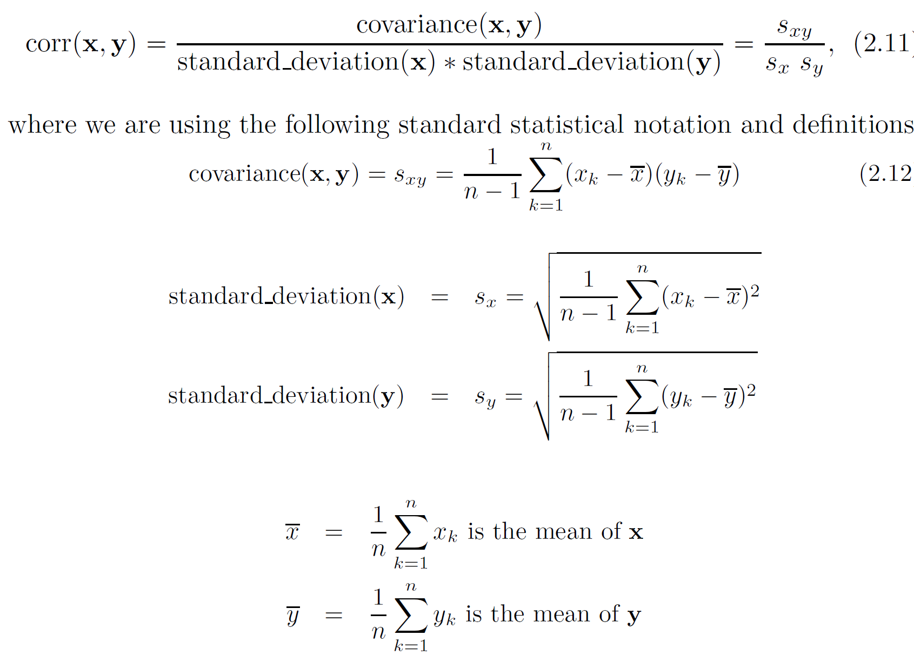
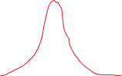
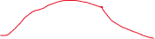
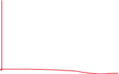
Correlation measures the linear relationship between objects

Slide 96
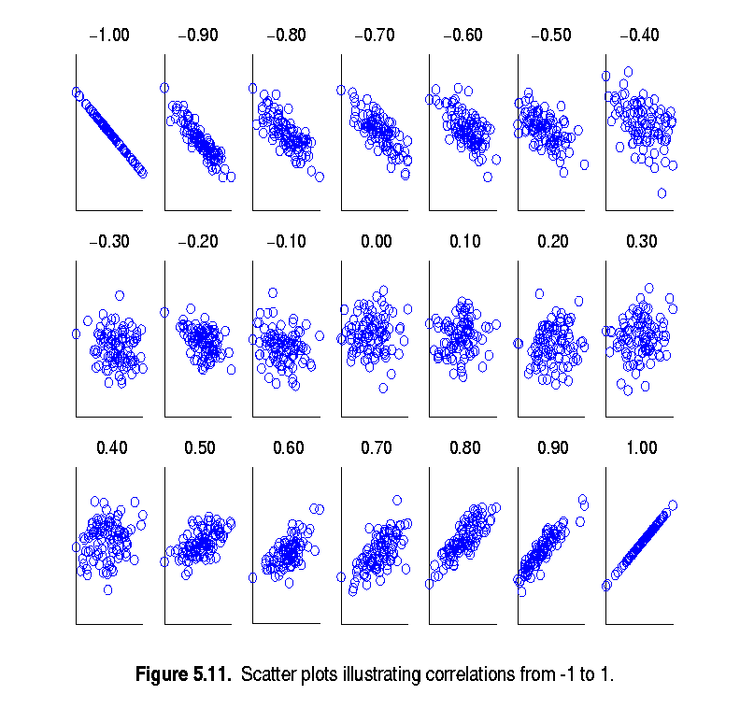
Visually Evaluating Correlation
Scatter plots showing the similarity from –1 to 1.

Slide 97
Drawback of Correlation
x = (-3, -2, -1, 0, 1, 2, 3)
y = (9, 4, 1, 0, 1, 4, 9)
y_{i} = x_{i}²
mean(x) = 0, mean(y) = 4
std(x) = 2.16, std(y) = 3.74
corr = (-3)(5)+(-2)(0)+(-1)(-3)+(0)(-4)+(1)(-3)+(2)(0)+3(5) / ( 6 * 2.16 * 3.74 )
= 0
Notes:
No linear relationship, correlation is 0, but non-linear relationship can exist

Slide 98
Correlation vs Cosine vs Euclidean Distance
Compare the three proximity measures according to their behavior under variable transformation
scaling: multiplication by a value
translation: adding a constant
Consider the example
x = (1, 2, 4, 3, 0, 0, 0), y = (1, 2, 3, 4, 0, 0, 0)
y_{s} = y * 2 (scaled version of y), y_{t} = y + 5 (translated version)
Property | Cosine | Correlation | Euclidean Distance
Invariant to scaling (multiplication) | Yes | Yes | No
Invariant to translation (addition) | No | Yes | No
Measure | (x , y) | (x , y_{s}) | (x , y_{t})
Cosine | 0.9667 | 0.9667 | 0.7940
Correlation | 0.9429 | 0.9429 | 0.9429
Euclidean Distance | 1.4142 | 5.8310 | 14.2127

Slide 99
Correlation vs cosine vs Euclidean distance
Choice of the right proximity measure depends on the domain
What is the correct choice of proximity measure for the following situations?
Comparing documents using the frequencies of words
Documents are considered similar if the word frequencies are similar
Comparing the temperature in Celsius of two locations
Two locations are considered similar if the temperatures are similar in magnitude
Comparing two time series of temperature measured in Celsius
Two time series are considered similar if their “shape” is similar, i.e., they vary in the same way over time, achieving minimums and maximums at similar times, etc.

Slide 100
Comparison of Proximity Measures
Domain of application
Similarity measures tend to be specific to the type of attribute and data
Record data, images, graphs, sequences, 3D-protein structure, etc. tend to have different measures
However, one can talk about various properties that you would like a proximity measure to have
Symmetry is a common one
Tolerance to noise and outliers is another
Ability to find more types of patterns?
Many others possible
The measure must be applicable to the data and produce results that agree with domain knowledge

Slide 101
Information Based Measures
Information theory is a well-developed and fundamental discipline with broad applications
Some similarity measures are based on information theory
Mutual information in various versions
Maximal Information Coefficient (MIC) and related measures
General and can handle non-linear relationships
Can be complicated and time intensive to compute
Notes:
Mutual information sometimes can be used as alternative to correlation particularly when there is a non-linear relationship is suspected.
Mutual information is a measure of how much information one set of values provides about another, given that the values come in pairs, i.e., height and weight. If they are independent, then the MI is 0.

Slide 102



Information and Probability
Information relates to possible outcomes of an event
transmission of a message, flip of a coin, or measurement of a piece of data
The more certain an outcome, the less information that it contains and vice-versa
For example, if a coin has two heads, then an outcome of heads provides no information
More quantitatively, the information is related to the probability of an outcome
The smaller the probability of an outcome, the more information it provides and vice-versa
Entropy is the commonly used measure

Slide 103

Entropy
For
a variable (event), X,
with n possible values (outcomes), x₁, x₂ …, x_{n}
each outcome having probability, p₁, p₂ …, p_{n}
the entropy of X , H(X), is given by
$$H\left(X\right)=−\sum_{i=1}^{n}{{p_{i}log}_{2}{p_{i}}}$$
Entropy is between 0 and log₂n and is measured in bits
Thus, entropy is a measure of how many bits it takes to represent an observation of X on average

Slide 104

Entropy Examples
For a coin with probability p of heads and probability q = 1 – p of tails
$$H=−p\log_{2}{p−}q\log_{2}{q}$$
For p= 0.5, q = 0.5 (fair coin) H = 1
For p = 1 or q = 1, H = 0
What is the entropy of a fair four-sided die?

Slide 105

Entropy for Sample Data
Suppose we have
a number of observations (m) of some attribute, X, e.g., the hair color of students in the class,
where there are n different possible values
And the number of observation in the i^{th} category is m_{i}
Then, for this sample
$$H\left(X\right)=−\sum_{i=1}^{n}{{\frac{m_{i}}{m}log}_{2}{\frac{m_{i}}{m}}}$$
For continuous data, the calculation is harder

Slide 106
Entropy for Sample Data: Example
Hair Color | Count | p | -plog₂p
Black | 75 | 0.75 | 0.3113
Brown | 15 | 0.15 | 0.4105
Blond | 5 | 0.05 | 0.2161
Red | 0 | 0.00 | 0
Other | 5 | 0.05 | 0.2161
Total | 100 | 1.0 | 1.1540

Slide 107

Mutual Information
Information one variable provides about another
Formally, $I\left(X,Y\right)=H\left(X\right)+H\left(Y\right)−H(X,Y)$, where
H(X,Y) is the joint entropy of X and Y,
$$H\left(X,Y\right)=−\sum_{i}{\sum_{j}{{pijlog}_{2}{pij}}}$$
Where p_{ij} is the probability that the i^{th} value of X and the j^{th} value of Y occur together
For discrete variables, this is easy to compute
Maximum mutual information for discrete variables is log₂(min( n_{X}, n_{Y} ), where n_{X} (n_{Y}) is the number of values of X (Y)

Slide 108
Mutual Information Example
Student Status | Count | p | -plog₂p
Undergrad | 45 | 0.45 | 0.5184
Grad | 55 | 0.55 | 0.4744
Total | 100 | 1.00 | 0.9928
Student Status | Grade | Count | p | -plog₂p
Undergrad | A | 5 | 0.05 | 0.2161
Undergrad | B | 30 | 0.30 | 0.5211
Undergrad | C | 10 | 0.10 | 0.3322
Grad | A | 30 | 0.30 | 0.5211
Grad | B | 20 | 0.20 | 0.4644
Grad | C | 5 | 0.05 | 0.2161
Total |  | 100 | 1.00 | 2.2710
Grade | Count | p | -plog₂p
A | 35 | 0.35 | 0.5301
B | 50 | 0.50 | 0.5000
C | 15 | 0.15 | 0.4105
Total | 100 | 1.00 | 1.4406
Mutual information of Student Status and Grade = 0.9928 + 1.4406 - 2.2710 = 0.1624

Slide 109
Maximal Information Coefficient
Reshef, David N., Yakir A. Reshef, Hilary K. Finucane, Sharon R. Grossman, Gilean McVean, Peter J. Turnbaugh, Eric S. Lander, Michael Mitzenmacher, and Pardis C. Sabeti. "Detecting novel associations in large data sets." science 334, no. 6062 (2011): 1518-1524.
Applies mutual information to two continuous variables
Consider the possible binnings of the variables into discrete categories
n_{X} × n_{Y} ≤ N^{0.6} where
n_{X} is the number of values of X
n_{Y} is the number of values of Y
N is the number of samples (observations, data objects)
Compute the mutual information
Normalized by log₂(min( n_{X}, n_{Y} ))

Slide 110
General Approach for Combining Similarities
Sometimes attributes are of many different types, but an overall similarity is needed.
1: For the k^{th} attribute, compute a similarity, s_{k}(x, y), in the range [0, 1].
2: Define an indicator variable, δ_{k}, for the k^{th} attribute as follows:
δ_{k} = 0 if the k^{th} attribute is an asymmetric attribute and
both objects have a value of 0, or if one of the objects has a missing value for the kth attribute
δ_{k} = 1 otherwise
3. Compute

Slide 111

Using Weights to Combine Similarities
May not want to treat all attributes the same.
Use non-negative weights $ω_{k}$
$similarity\left(x,y\right)= \frac{\sum_{k=1}^{n}{ω_{k}δ_{k}s_{k}(x,y)}}{\sum_{k=1}^{n}{ω_{k}δ_{k}}}$
Can also define a weighted form of distance

Slide 112

Kernel Functions
Proximity can be used for predictive modeling through kernel matrix K, k_{ij} = k(x_{i},x_{j})
Non-linear relationship can be modeled using models designed for linear relationship
Kernels make an algorithm data independent

Slide 113

Kernel Functions
Mapping data into a higher dimensional data space can allow modeling of nonlinear relationships.
Transforming data from a lower dimensional data space to a higher dimensional space

Slide 114
Bregman Divergence
Dissimilarity measure
x and y two data points, y is original and x is distorted y (by adding some noise)
Now estimate y from x, and measure the distortion

Slide 115
Reading
Introduction to Data Mining by Tan et al. – Chapter 2
Data Mining by Aggarwal – Chapter 2

